Slide 1
SERRF Validation (Draft)

Slide 2
Changes Made
Changes were made to the python version of SERRF to correct errors in the implementation
All changes are thoroughly explained in CHANGELOG.md
Summary of changes made:
  Modified order of operations for normalization method (SERRF.fit_predict)
  Fixed error in QC normalization procedure
  Inverted Logic for a scaling condition
  Adjusted feature selection for model builiding
  Created option to utilize R’s ranger package inside Python
  Adjusted sklearn’s random forest regressor hyperparameters to reflect R’s ranger package defaults
  Modified location and scale of distribution for sampling to fix negative values

Slide 3
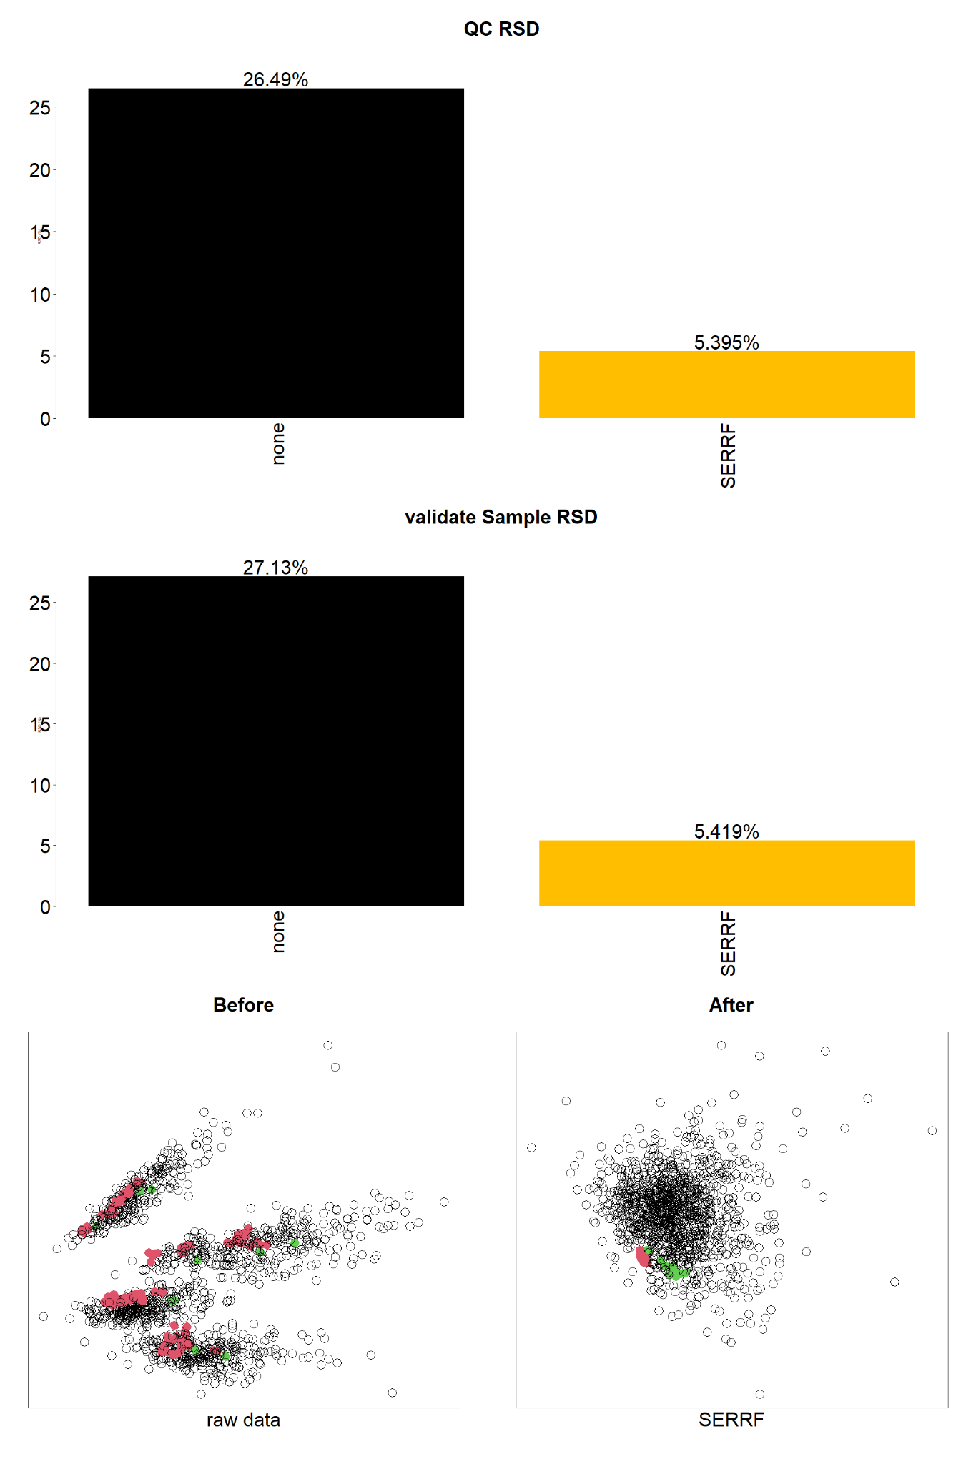
SERRF Example Dataset Figures
QCRSD - RSD of QC samples (125) prior to correction. Performs outlier removal prior to calculating RSD using Interquartile Range (IQR) * 1.5
Validate sample RSD - selected a random subset of 25 samples, computed the RSD after removing outliers using IQR * 1.5, computed the average for each metabolite (268) across validate sets (5) and then reported the median value as a summary statistic

Slide 4
Cross-Validation Description
Cross validation is a method to ensure that your ML model generalizes well.
Cross validation is for model evaluation not for model building
SERRF reports a 5-fold cross validation scheme where a random subset of qc samples (training data) and biological samples (testing data) are selected and used as the input for SERRF. This builds 5 models (1 for each subset) and allows for assessment of how well the model generalizes when seeing different combinations of the data
For our purpose of evaluating an implementation we can just look at the SERRF model built using all of the data (i.e SERRF’s final output)
This could be a good idea to implement but would be very time-consuming for NPH datasets.

Slide 5
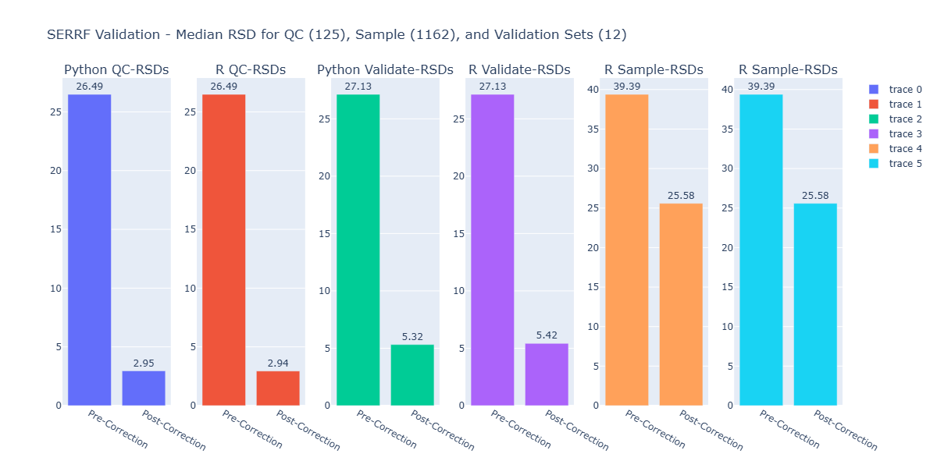
New Figures
For this comparison, I compared the final output of SERRF where the model sees:
  All QC samples (125) and biological samples without “validate”/holdout set (1287)
  All QC samples (125) and only “validate”/holdout set (12)
This was conducted to reflect exactly what we are seeing in the PCA plot and the final table output

Slide 6
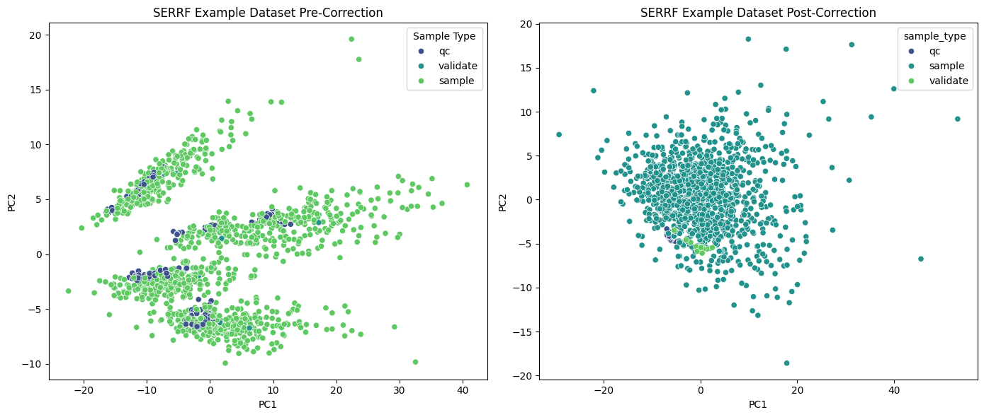
PCA

Slide 7
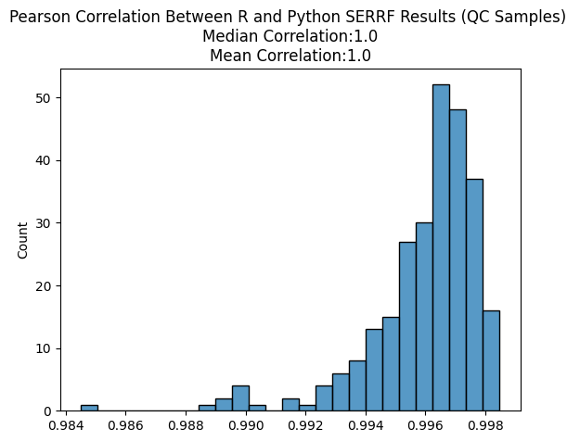
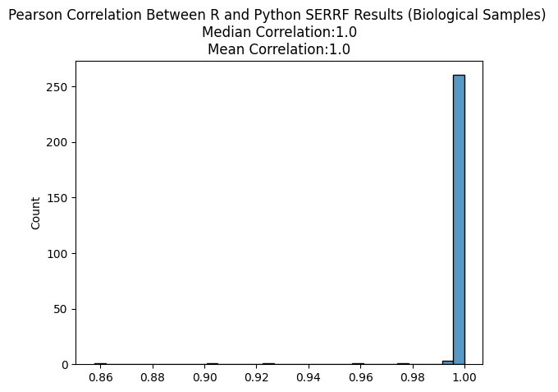
Correlation Analysis

Slide 8
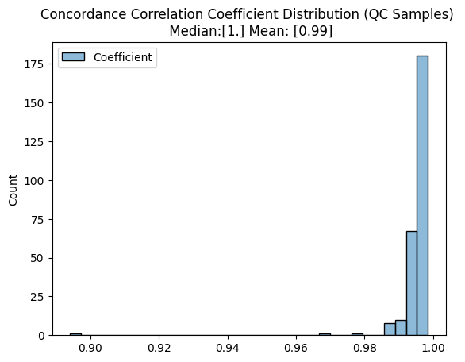
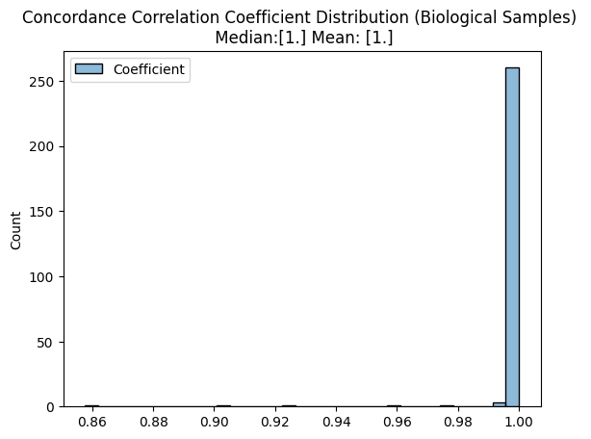
Concordance Correlation Coefficient
The Concordance Correlation Coefficient (CCC) is a metric that can be used alongside Pearson correlation to assess agreement between two continuous variables.
While Pearson correlation measures the strength of the linear relationship, it does not account for differences in scale or systematic bias.Two methods can have a high Pearson correlation even if their values differ substantially in magnitude.
CCC incorporates both precision (correlation) and accuracy (agreement in scale and location).
The CCC is influenced by the range of values. A narrow range of measurements will typically yield a lower CCC even if the methods agree well, while a wider range can inflate the CCC.

Slide 9
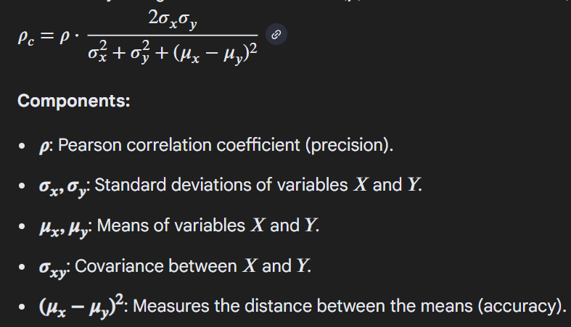
Concordance Correlation Coefficient

Slide 10
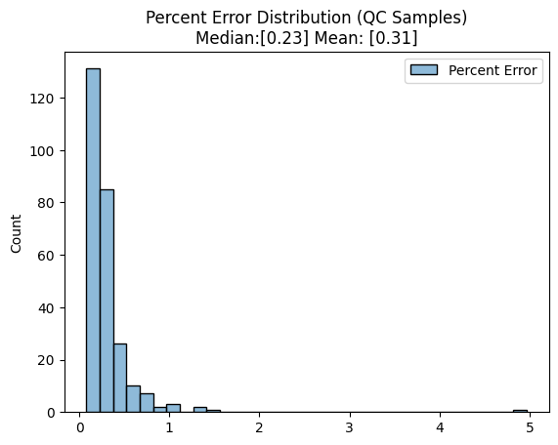
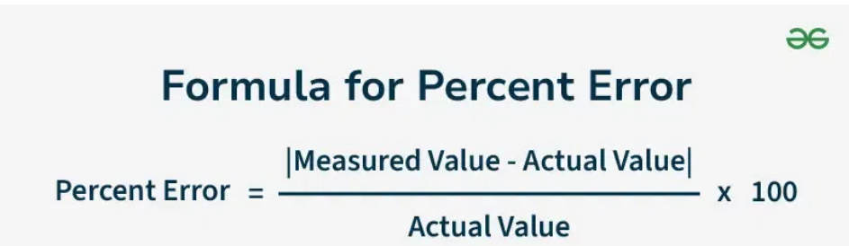

Percent Error
Percent error quantifies the difference between your experimental and expected value.
Since the goal is replication of R results, R output is treated as the actual value and Python as measured value.

Slide 11
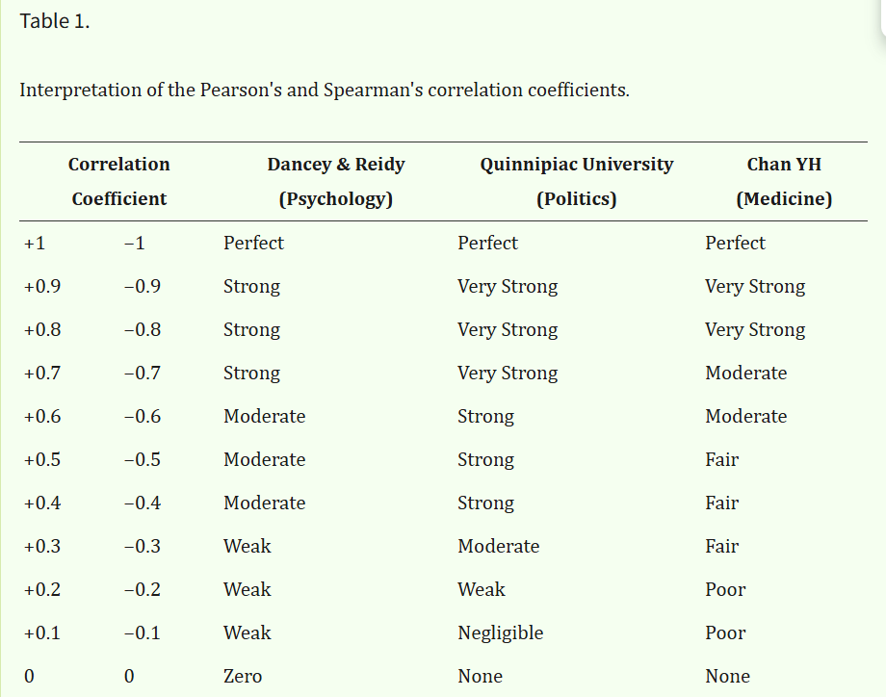
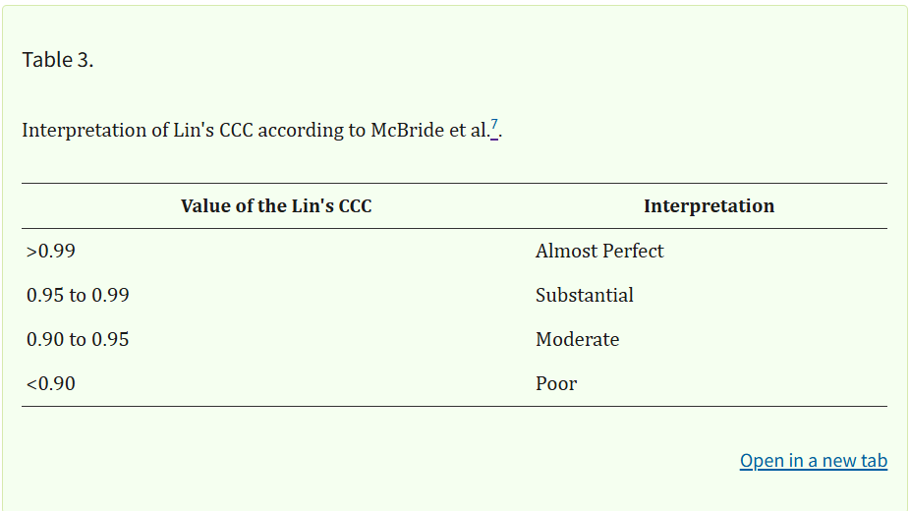
Outlier Evaluation
Identify Outliers in each Metric’s distribution using known thresholds
For each outlier plot R vs Python scatter plot and R vs Python intensity distribution
Report summary statistics: Mean, Standard Deviation
User's guide to correlation coefficients (<0.95 for correlation coefficients)
Set an arbitrary cutoff of 5% for percent error.

Slide 12
 | Percent Error (outlier if >5) | Concordance Correlation (outlier if <0.95) | Pearson Correlation (outlier if <0.95)
Across Quality Control Samples | None | MET205,MET215 | None
Across Biological Samples | MET190,MET215 | MET190,MET205,MET206,MET215 | MET190,MET205,MET206,MET215
4 main features that are somewhat out of agreement between implementations.
Despite having utilized the same model with the same RNG “seed” there still are some differences
Some operations require sampling from a distribution. This was conducted strictly in python so this could be a potential explanation for variability.
Concordance Correlation Coefficient can be adversely affected by the variance/spread of a feature.
Random forest predictions depend on comparisons like x <= threshold. When a sample's feature value is very close to a split threshold, tiny floating-point differences between R and Python can send it down a different branch. This cascades — one wrong turn early in a tree can lead to a dramatically different leaf value.

Slide 13
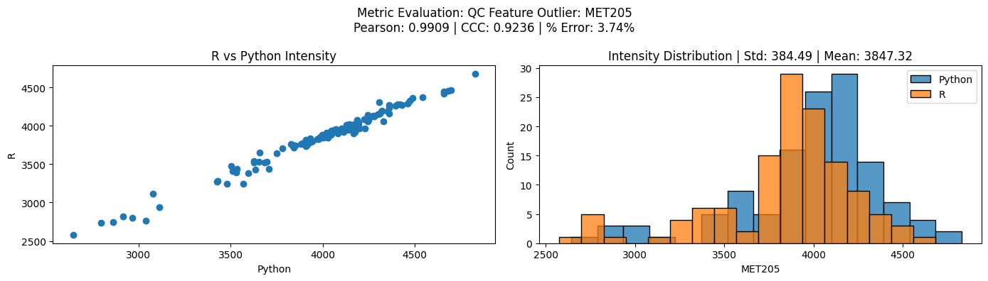
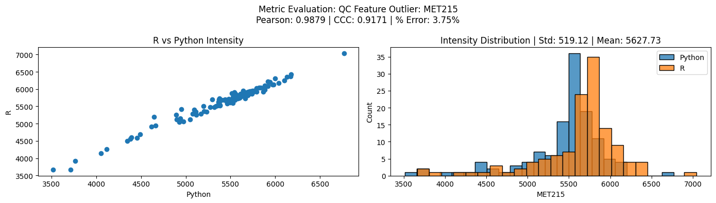

Slide 14
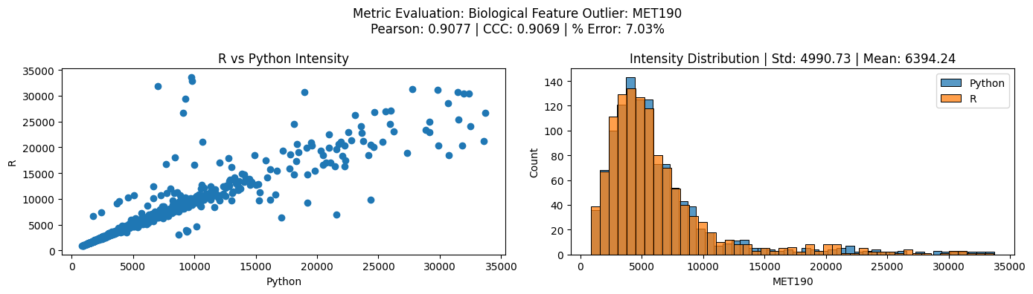
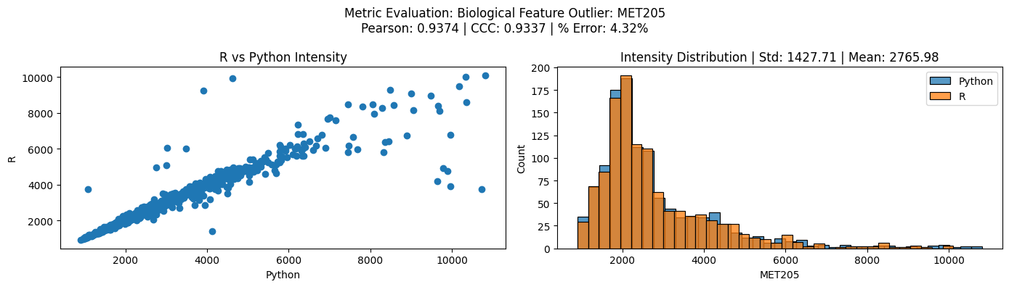

Slide 15
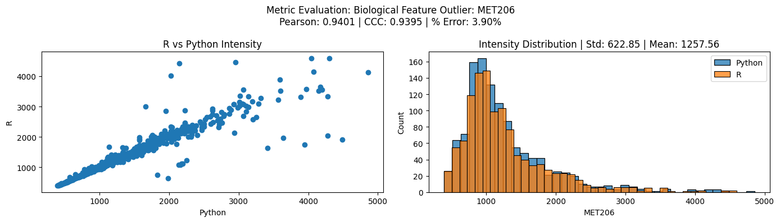
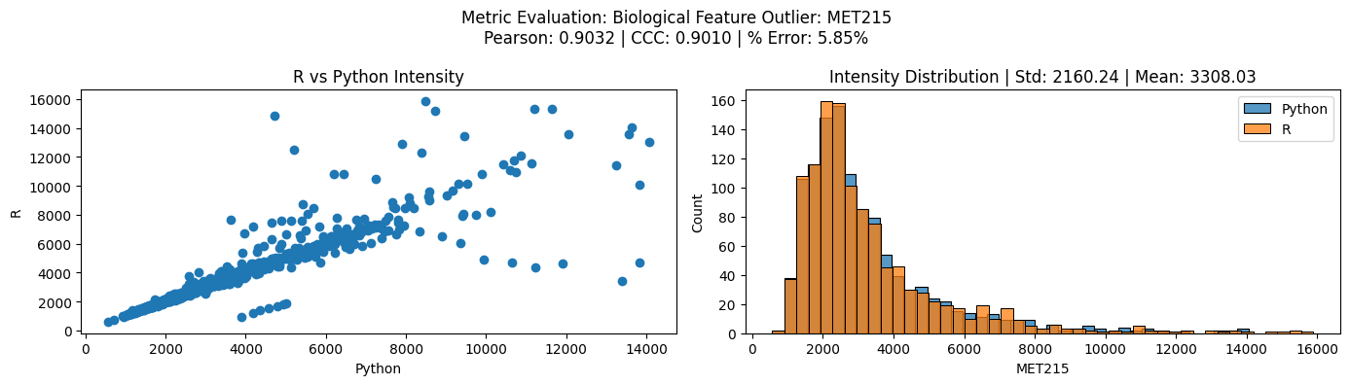

Slide 16
Next Steps
Test python implementation on a larger dataset.
Consider using python-exclusive RF model to allow for efficiency gains.
Compare with “BroadHurst Method (hybrid approach)”

